Slide 1
Introduction to SDLC
By Dhruv Sompura

Slide 2
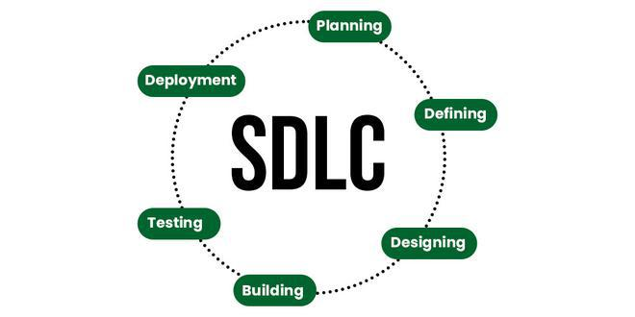
What is SDLC?
Software development life cycle (SDLC) is a structured process that is used to design, develop, and test good-quality software. SDLC, or software development life cycle, is a methodology that defines the entire procedure of software development step-by-step.
The goal of the SDLC life cycle model is to deliver high-quality, maintainable software that meets the user’s requirements. SDLC in software engineering models outlines the plan for each stage so that each stage of the software development model can perform its task efficiently to deliver the software at a low cost within a given time frame that meets users’ requirements.

Slide 3
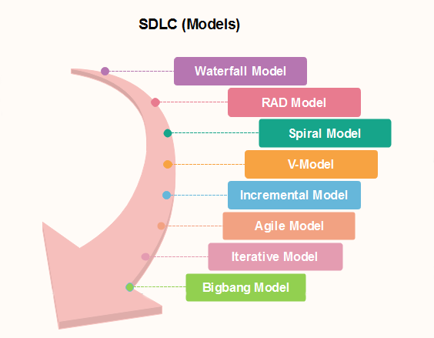
Drawbacks for each model
Waterfall Model:
Inflexibility to Change, Late Testing, No Overlapping Phases, Client Involvement is Minimal
V-Model:
Rigid Structure, Limited Flexibility, Testing Based on Documentation, High Costs for Changes
Spiral Model:
Complexity, High Cost, Requires Expertise, Not Suitable for Small Projects
Iterative Model:
Incomplete Early Deliverables, Requires Clear Module Interface, Risk of Scope Creep, Integration Challenges

Slide 4
Opinion: Is SDLC the Correct Approach to Follow?: Yes.
1. Structured Process
SDLC provides a clear, structured framework for project execution.
Helps in breaking down complex software development into manageable phases.
Ensures each phase is documented, promoting transparency.
2. Risk Mitigation
Identifies potential issues early through defined stages like analysis, design, and testing.
Early identification reduces chances of costly changes later in the development process.
3. Predictability & Planning
Fosters detailed planning for resources, timelines, and budget.
Helps set expectations for stakeholders and maintain predictable progress.

Slide 5

Any questions?

